Slide 1

Fall Detection System Using Sensors Embedded In Smartphones
By,
Jathin Sreenivas,
Vineeth Bhat,
Vidya Gopalakrishnarao

Slide 2
Project Vision
Smartphones are embedded with sensors using which we can extract data to perform various human activity recognition. This projects uses that idea to detect a fall and propose a fall detection system using sensors embedded in smartphones.

Slide 3
Requirements
Functional requirements:
Fall Detection
Accessing sensor
Trigger alarm
Trigger SMS alert
Acknowledgement
Non Functional Requirements:
Real time
Accuracy
Scalability
User friendly
Reliability
Security
Privacy
Confidentiality
Access permission
Authentication

Slide 4
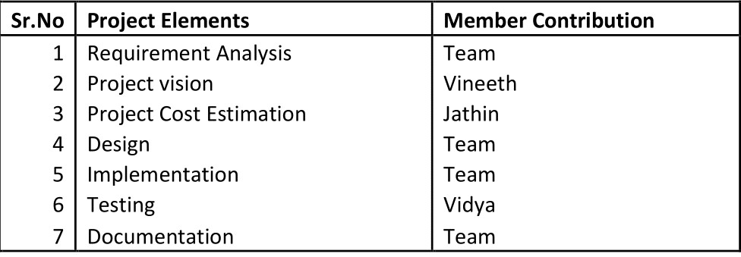
Resource Utilization

Slide 5
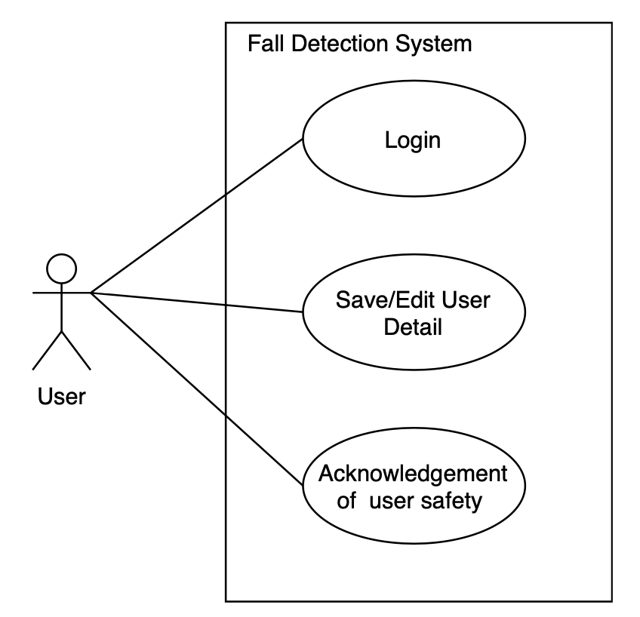
Use Case

Slide 6
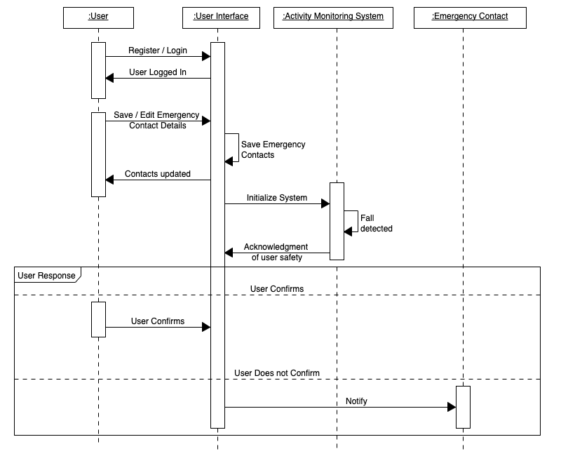
Sequence Diagram

Slide 7
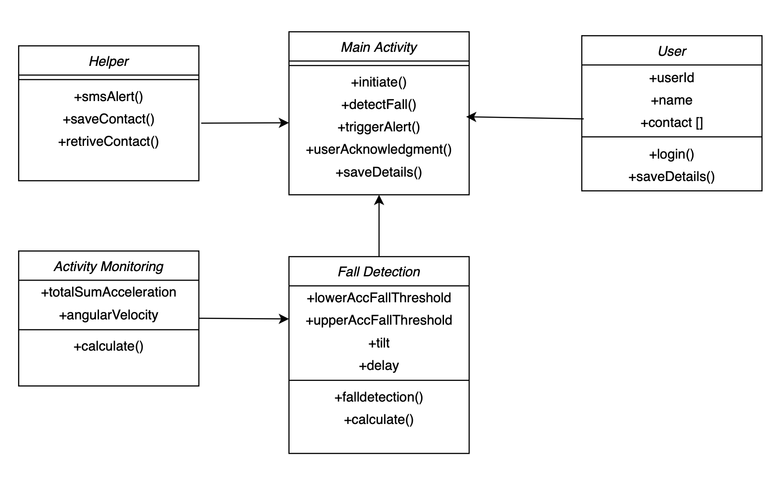
Class Diagram

Slide 8
Project Estimation
We are using Function Point Analysis and COCOMO model to predict the development time and effort for our project.
The development time will be 4.2156 months/person or 3.955 person/month.
Source Lines of Code( SLOC ) = 1609.3
Programmer Productivity( PM )= 3.95530 person/month
Development time( DEV )= 4.2156 months

Slide 9
Development environment
Development Environment: Android
Hardware sensors are accessed using the dedicated android hardware package (android.hardware). It includes the following classes and interfaces.
SensorManager
Sensor
SensorEvent
SensorEventListner
Hardware and Software
Smartphone: Google Pixel
Operating System: Android
IDE: Android Studio
Version Control: GitHub
Sensors Used
Accelerometer
Gyroscope

Slide 10
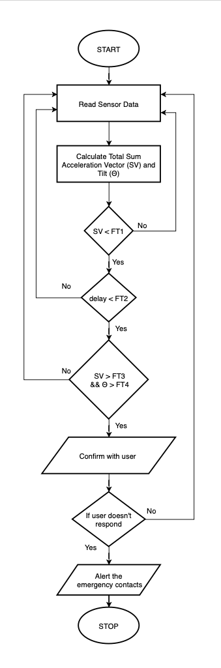
Flowchart

Slide 11
References
[1] Sensors: https://developer.android.com/guide/topics/sensors Accessed:09.06.2020
[2] Gyroscope: https://ef.engr.utk.edu/hyperphysics/hbase/gyr.html Accessed: 09.06.2020
[3] Live Science: https://www.livescience.com/40102-accelerometers.html Accessed: 09.06.2020
[4] Cost Estimation, Padmaja, http://people.cs.ksu.edu/ padmaja/Project/CostEstimate.html Accessed: 09.06.2020
[5] E. Thammasat and J. Chaicharn, ”A simply fall-detection algorithm using accelerometers on a smartphone,” The 5th 2012 Biomedical Engineering International Conference, Ubon Ratchathani, 2012, pp. 1-4, doi: 10.1109/BMEiCon.2012.6465471.
[6] F. Sposaro and G. Tyson, ”iFall: An android application for fall monitoring and response,” 2009 Annual International Conference of the IEEE Engineering in Medicine and Biology Society, Minneapolis, MN, 2009, pp. 6119-6122, doi: 10.1109/IEMBS.2009.5334912.
[7] S. Abdelhedi, R. Bourguiba, J. Mouine and M. Baklouti, ”Development of a two-threshold-based fall detection algorithm for elderly health monitoring,” 2016 IEEE Tenth International Conference on Research Challenges in Information Science (RCIS), Grenoble, 2016, pp. 1-5, doi: 10.1109/RCIS.2016.7549315.
[8] Bourke, Alan O´ Laighin, Gearo´id. (2008). A threshold-based falldetection algorithm using a bi-axial gyroscope sensor. Medical engineering physics. 30. 84-90. 10.1016/j.medengphy.2006.12.001.
[9] H. W. Guo, Y. T. Hsieh, Y. S. Huang, J. C. Chien, K. Haraikawa and J. S. Shieh, ”A threshold-based algorithm of fall detection using a wearable device with tri-axial accelerometer and gyroscope,” 2015 International Conference on Intelligent Informatics and Biomedical Sciences (ICIIBMS), Okinawa, 2015, pp. 54-57, doi: 10.1109/ICIIBMS. 2015.7439470.

